Slide 1

STREET SAFETY ANALYSIS
VARSHITHA YANAMALA
DATA 602-INTRODUCTION TO DATA ANALYSIS AND MACHINE LEARNING
UNIVERSITY OF MARYLAND, BALTIMORE COUNTY
PROF. DEVIN FENSTERHEIM

Slide 2
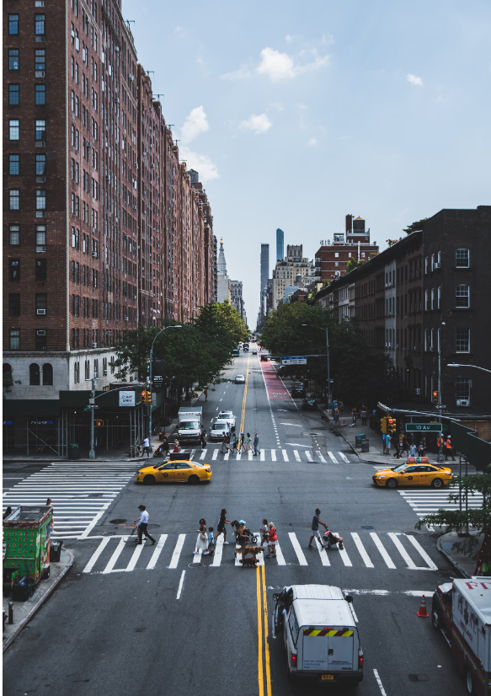
INTRODUCTION
BUSINESS PROBLEM:
Determine the safety of streets using data from 311 service requests, crimes, and traffic accidents
MOTIVATION:
Provide Insights to stakeholders like city planners, law enforcement and residents.
Help allocate resources effectively to improve street safety.

Slide 3
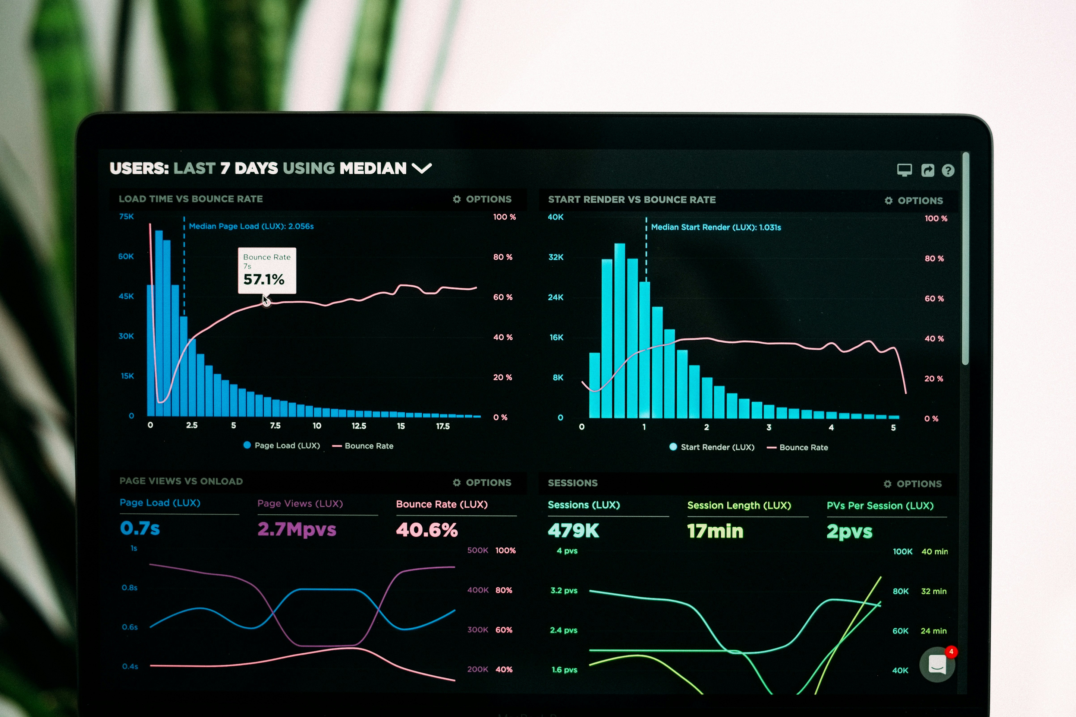
DATA OVERVIEW
1
Datasets Used
Crimes Dataset (26000, 22)
311_requests (26000, 37)
Traffic_crashes (26000, 22)
2
Data Sources:
City of Chicago Open Data Portal.
Link: https://data.cityofchicago.org/
3
Key Attributes:
Latitude, Longitude, Incident Types, Dates,
Crime_types

Slide 4
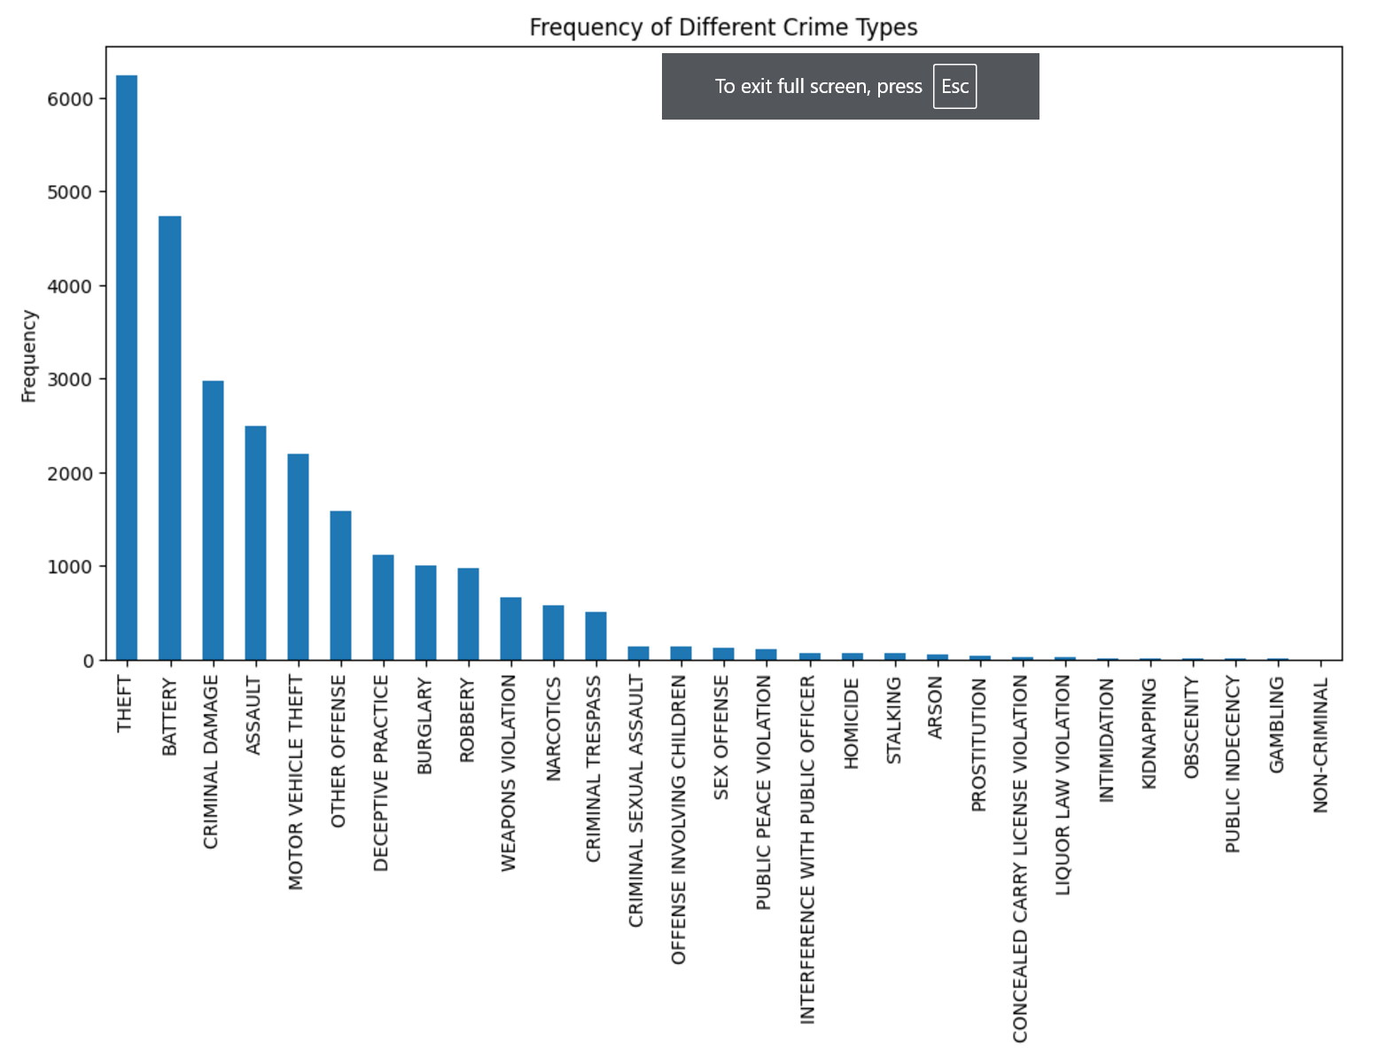
DATA PREPROCESSING AND INTEGRATION
1
Data Cleaning:
Handling missing values, replacing with suitable defaults (e.g., unknown for categorical values).
Dropping irrelevant columns and aggregating data.
2
Data Integration:
Geospatial Join: Merging datasets using latitude and longitude with Geopandas.
Creating new features for incidents at each unique location.

Slide 5
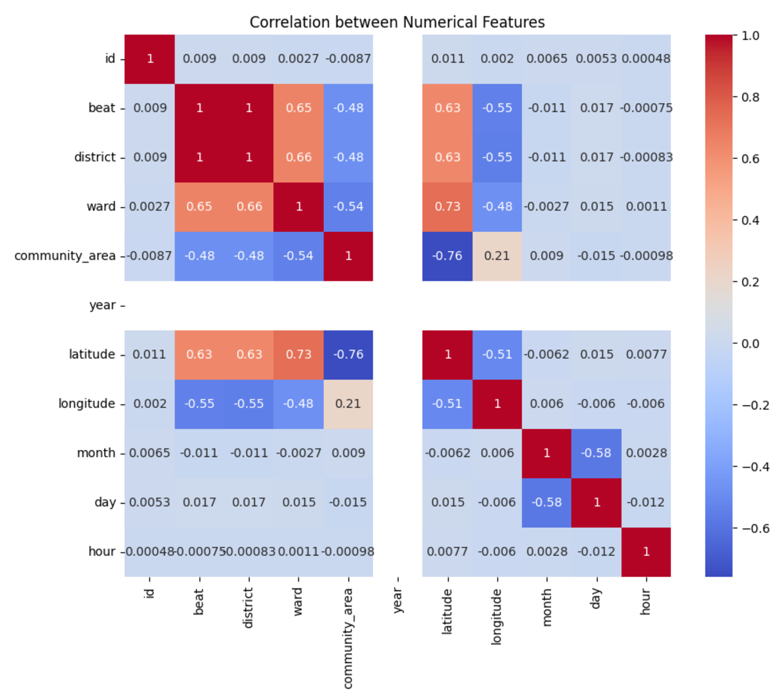
FEATURE ENGINEERING
Features Extracted:
High correlations, like between beat and district, suggest redundancy. One of these features might be dropped to avoid multicollinearity in predictive models.
Interactions between latitude, community_area, and ward could be explored for clustering or categorization.
Analysis Focus:
Geographic features (latitude, longitude) show moderate relationships with administrative features (ward, beat, community_area). This could be useful in spatial analysis.

Slide 6
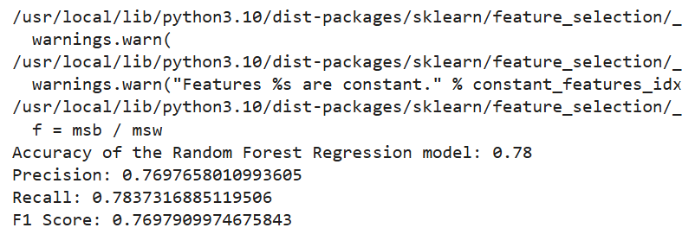
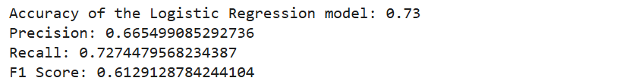
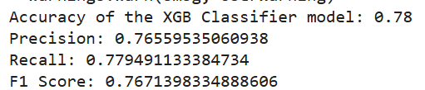
MODELING APPROACH:
Models Used:
Random Forest Classifier
Logistic Regression Model
XG Boost Classifier

Slide 7
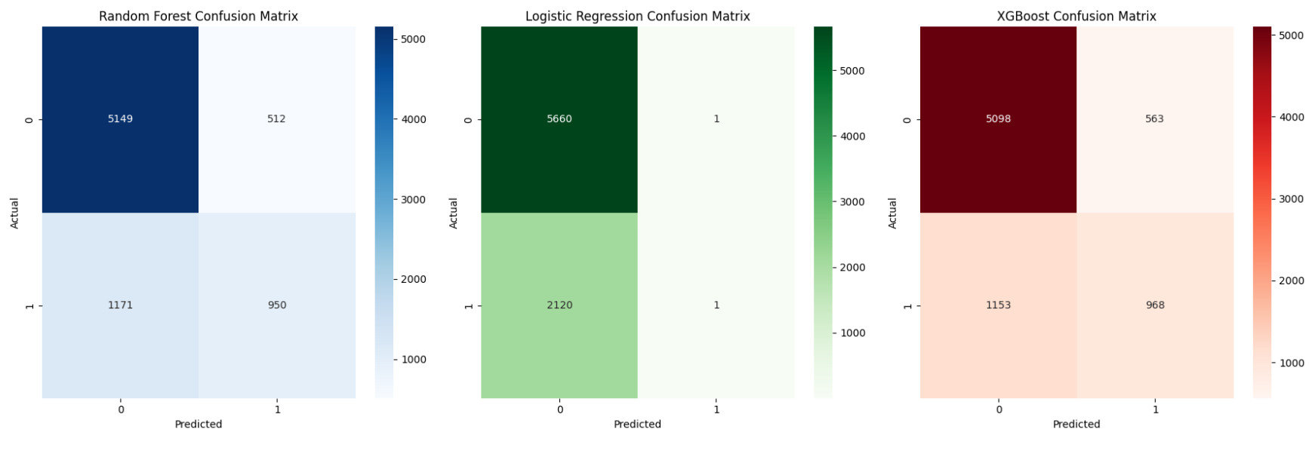
RESULTS AND DISCUSSION:
Confusion Matrices:

Slide 8
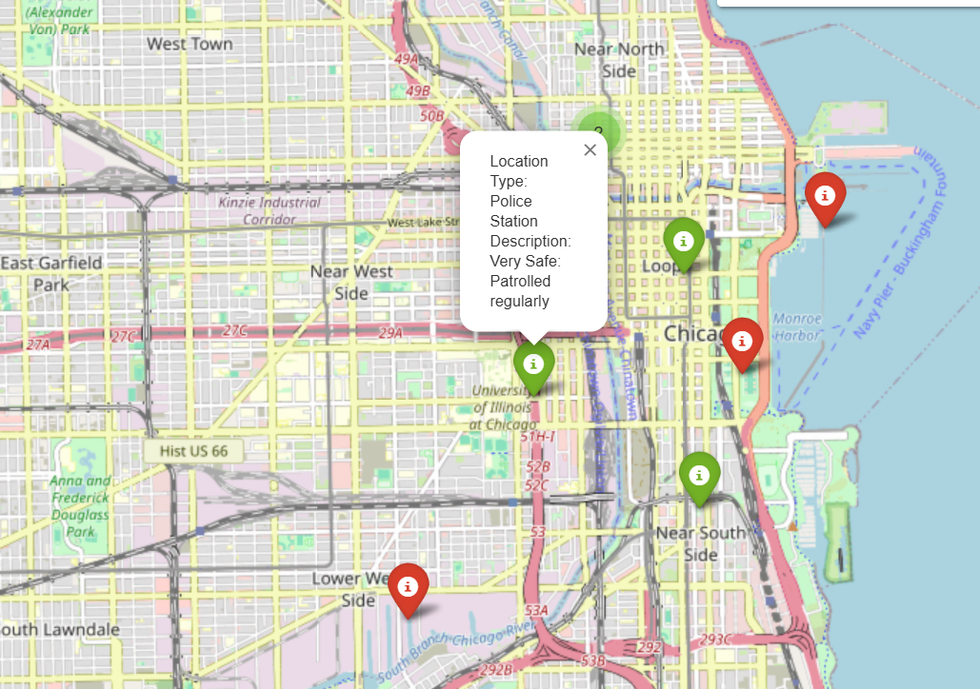
VISUALIZATION OF SAFETY CLASSES:
Map Visualization:
Locations colored by safety class:
Green: Safe
Red: Unsafe
Shows clusters of locations requiring attention.

Slide 9

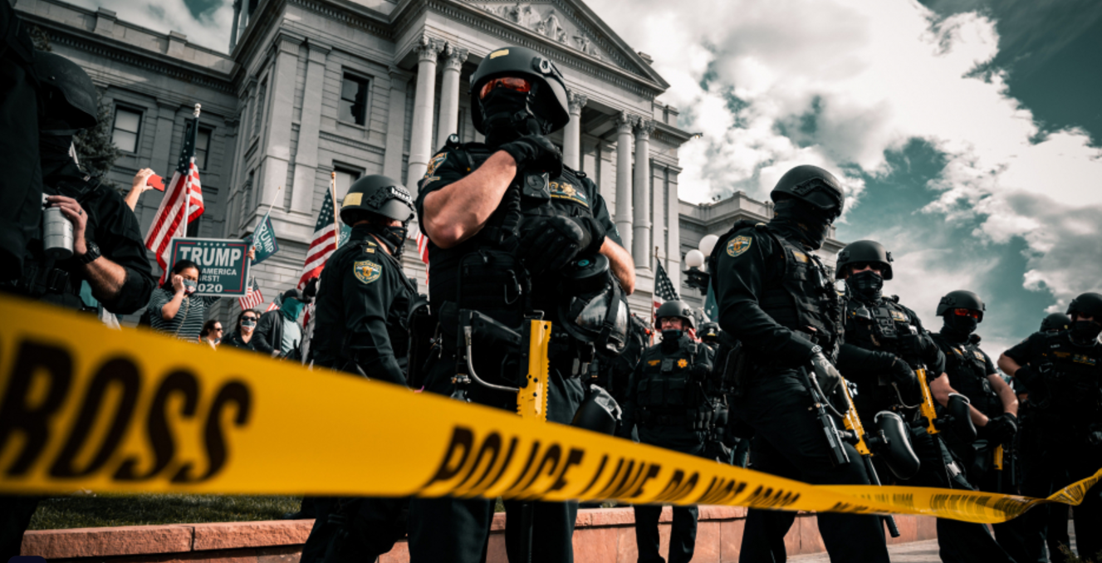
CONCLUSIONS AND RECCOMMENDATIONS:
Summary of Findings:
High incidents of crime and traffic significantly reduce street safety.
Most locations fall into the Safe class.
Recommendations:
For City Planners: Allocate resources to Unsafe areas for infrastructure improvements.
For Law Enforcement: Increase patrolling in Unsafe areas.
For Community Leaders: Organize safety workshops in Moderate areas.

Slide 10
Acknowledgements and Q&A
Acknowledgements:
Data provided by City of Chicago Open Data Portal.
Tools used: Python, Pandas, Scikit-learn, Geopandas, Folium.
FEEL FREE TO ASK QUESTIONS......?

Slide 11
THANK YOU

